Slide 1
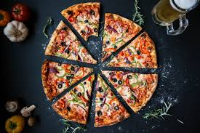
SQL Project on Pizza Sales

Slide 2
Topics
In this project I have utilise sql quires to solve ques that are related to pizza sales.

Slide 3

Retrieve the total number of orders placed

Slide 4
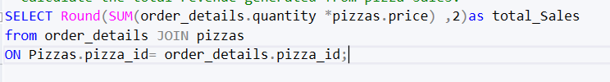

Calculate the total revenue generated from pizza sales.

Slide 5
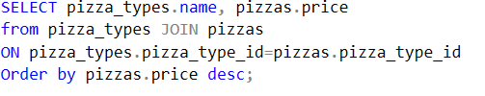
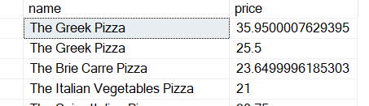
Identify the highest-priced pizza.

Slide 6
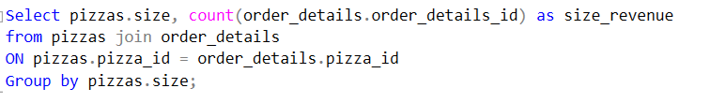
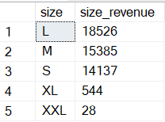
Identify the most common pizza size ordered.

Slide 7
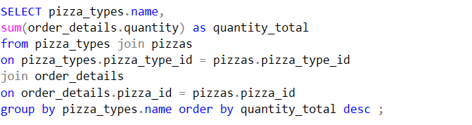
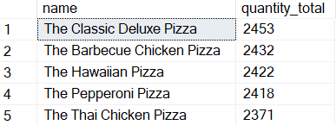
List the top 5 most ordered pizza types along with their quantities.

Slide 8
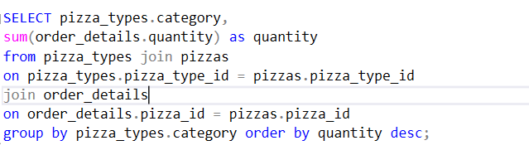
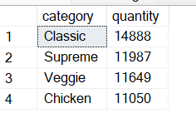
Join the necessary tables to find the total quantity of each pizza category ordered.

Slide 9

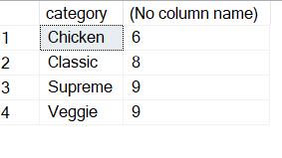
Join relevant tables to find the category-wise distribution of pizzas.

Slide 10
Determine the distribution of orders by hour of the day.
select hour(time), count(order_id) from orders
group by hour(time);

